Slide 1

Low-Power and Fast Full-Adder by exploring new XOR and XNOR gates
By
Student Name:Konda Hemanth Kumar
Institute Name:Indian Institute of information Technology
Ranchi
Under the guidance of
Prof. M. Suresh
Konda Hemanth Kumar
Notes:
B-TECH PROJECT MID-SEM PRESENTATION 2011
BY KHUSHBU KHAN & ISAN SAHOO

Slide 2
Content:
Aim/Objective
Presenting Literature Review
Methodology
Circuits used
Process
Full-Adder Circuits and Waveforms
Simulation Results
Power, Delay and PDP Comparison.
Outcomes
Applications
Future Tasks & Conclusion
References
Konda Hemanth Kumar

Slide 3
Aim & Objective:
The aim of the project is to design a Full-Adder circuit using XOR and XNOR logic gates which will have less power Consumption and will work with high speed.
Objective:
The existing Full-Adder circuits uses more transistors. So our objective is to design circuits that will have:
Low Power-Consumption
Less Delay
Less PDP
Konda Hemanth Kumar

Slide 4
Abstract:
This project for designing of Full-Adder is proposed by using CMOS level XOR and XNOR gates. Three hybrid full-adder circuits are designed using new XOR and multiplexer gates. These circuits is designed to have minimal power consumption, delay and most significantly PDP compared to existing full-adder circuits. Each one of the full-adder circuit is having its own advantages of speed, power consumption.
Simulation is done in Tanner Tool in 250nm Technology. From the results newly designed circuits are found to be better than existing circuits. Also the performance of full adder circuits are analysed by varying the input supply voltage.
Konda Hemanth Kumar

Slide 5
Introduction:
The use of handheld mobile devices has skyrocketed in recent years. These devices would use less power and operate at a high speed. Power consumption is a metric that can be designed for improved device efficiency when planning a system.
A full adder is a fundamental block in many circuits that execute arithmetic operations. As a result, the performance of the full adder has an impact on the overall machine performance. As a consequence, improving the efficiency of the full adder will boost device performance. Many full adder circuits have been constructed using different logic types, each with its own set of advantages and drawbacks.
Konda Hemanth Kumar

Slide 6
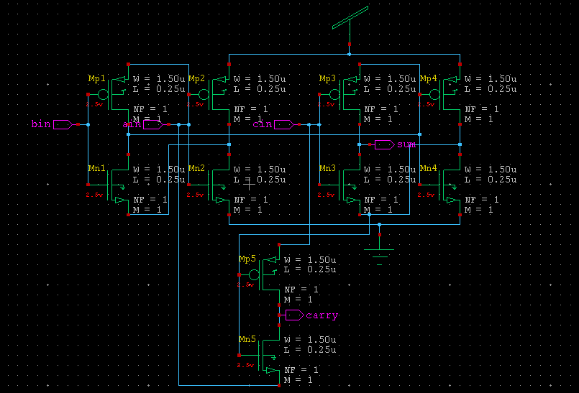
10T FULL ADDER
Konda Hemanth Kumar

Slide 7
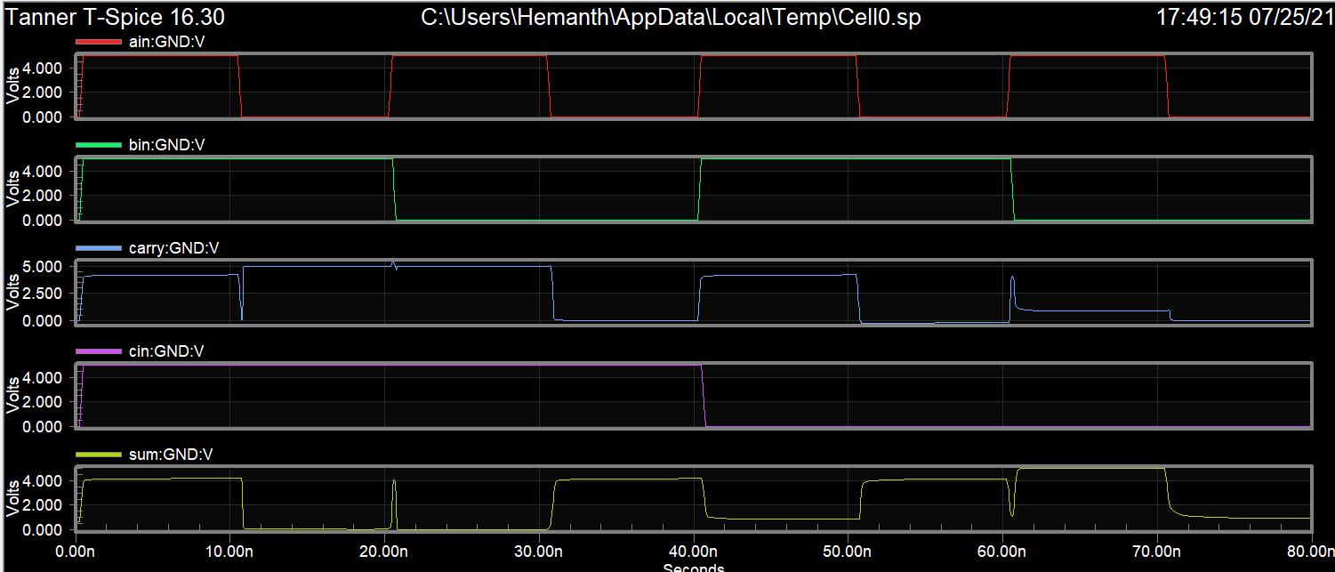
10T FULL ADDER WAVE FORM
Konda Hemanth Kumar

Slide 8
Methodology:
XNOR, XOR, AND and OR gates are often used in the construction of full adders. These gates uses more power in a full-adder. So the full-adder's power consumption can be minimised by reducing the transistors from those gates
And hence we tried to minimize these effects by changing the W/L ratio, minimizing the number of transistors and compared the power consumption, Delay, PDP, and Noise with previously existing circuits and we got better results compare the results of existing circuits.
We have designed a circuits which is having 12 transistors, 8 transistors and 14 transistors and will design a few circuits which will from references.
Testing, Analysing and simulation of circuits is done in a Tanner tool in 250nm technology.
Konda Hemanth Kumar

Slide 9
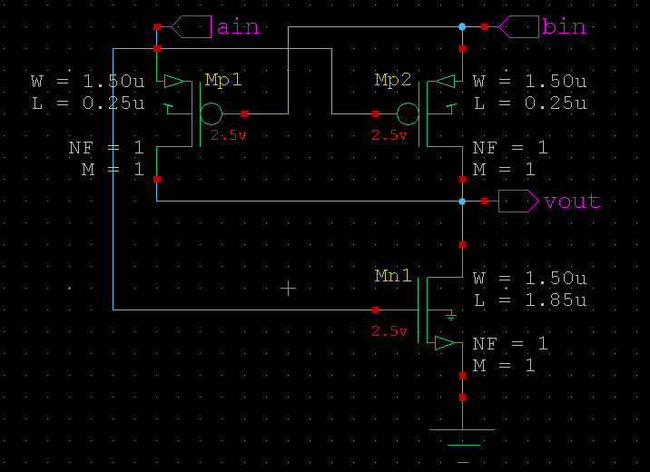
Circuits used:
3T-XOR: This XOR is a 3 transistors circuit. It is not gate with a pass transistor.
Konda Hemanth Kumar

Slide 10
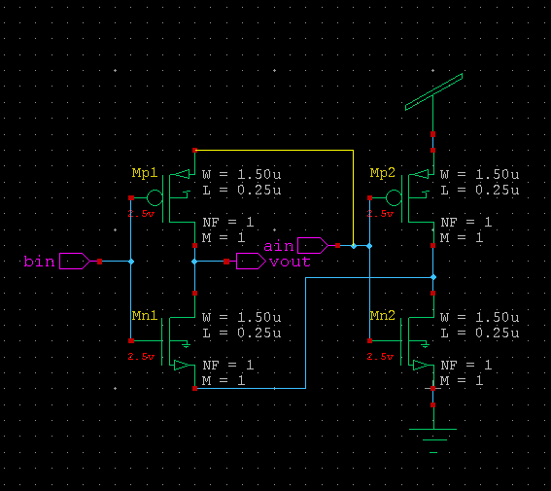
4T-XOR
4T-XOR: This is a not gate based XOR gate which has bin as
input, ain as supply to pmos and output of ain as supply to nmos.
Konda Hemanth Kumar

Slide 11
Multiplexer
Multiplexer: The multiplexer will be used for obtaining carry by using output of 3T-XOR gate as selector and ain, cin as supply.
Multiplexer Equation = ̅̅S.a + S.c
Considering S as outKonda Hemanth Kumar
put of XOR gate,
the multiplexer equation becomes:
̅xor.a + xor.c = xnor.a + xor.c = a.b + xor.c ...(1)
Here equation (1) is the equation for carry.
In this way we calculated and designed for carry:
Konda Hemanth Kumar

Slide 12
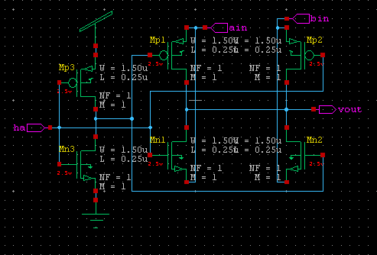
MULTIPLEXER CIRCUIT
Konda Hemanth Kumar

Slide 13
Process:
8T Full Adder
We have used 3T XOR gates in 8T full adder. 3T XOR is a combination of a CMOS inverter with a transistor. When input B=1, the output is the complement of the CMOS inverter and when B=0, the output acts an inverter. When A=1 and B=0, both PMOS and NMOS are switching on, because of the W/L ratio of PMOS threshold voltage is minimum comparative NMOS that the reason PMOS is conducted first & the output is same as the input A. As we got the output of 3T XOR gate, the output is connected to the first input of the second 3T XOR gate with C as the second input. By this we will get the sum from the output of the second 3T XOR gate.
To obtain carry we have use a not gate based multiplexer by giving A input as supply to pmos, C as supply to nmos and XNOR as input.
Konda Hemanth Kumar

Slide 14
12T Full Adder
We have used 4T-XOR gate in 12T Full Adder circuit. The 4T-XOR gate is two not gate based circuit. Bin is the input, ain is the supply for pmos and complement of ain is the supply for nmos. To obtain the complement of ain we have used another not gate. To obtain carry we use same operation as in 8T.
14T Full Adder
We have used 4T-XOR gate in 14T Full Adder circuit. The 4T-XOR gate is two not gate based circuit. Bin is the input, ain is the supply for pmos and complement of ain is the supply for nmos. To obtain the complement of ain we have used another not gate.
Carry is obtained from the multiplexer. Here the input is connected with the output of AxorB. When AxorB=1, then carry=C and if AxorB=0, then carry=A.
Konda Hemanth Kumar

Slide 15
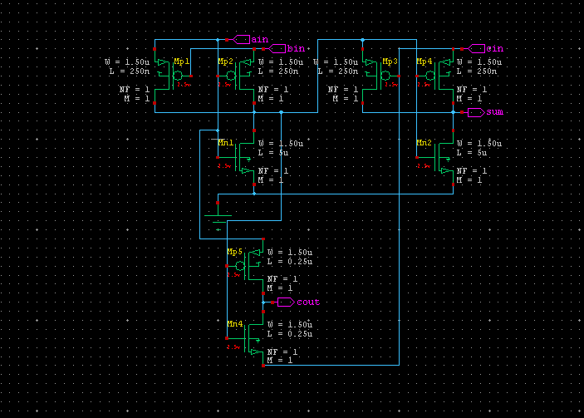
8T-Full-Adder:
Konda Hemanth Kumar

Slide 16
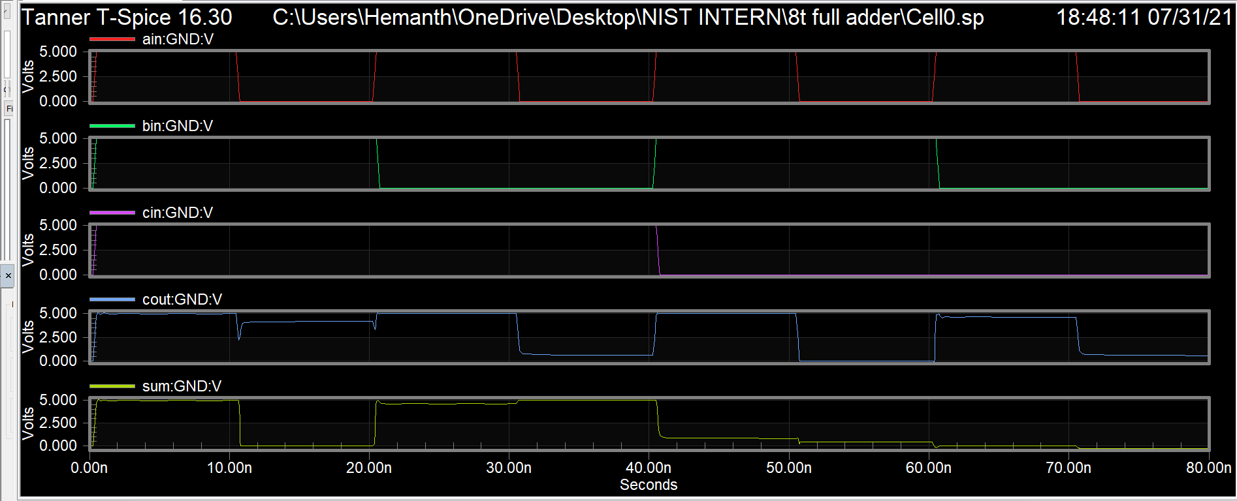
8T FULL ADDER WAVE FORM
Konda Hemanth Kumar

Slide 17
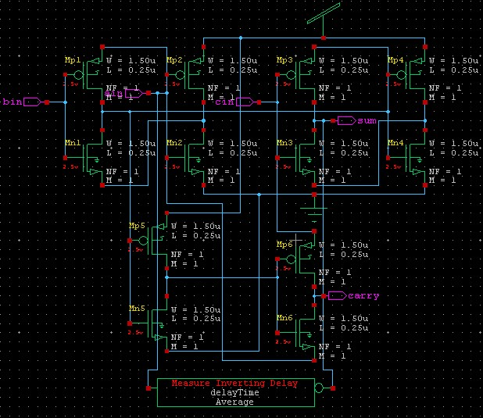
12T FULL ADDER CIRCUIT:
Konda Hemanth Kumar

Slide 18
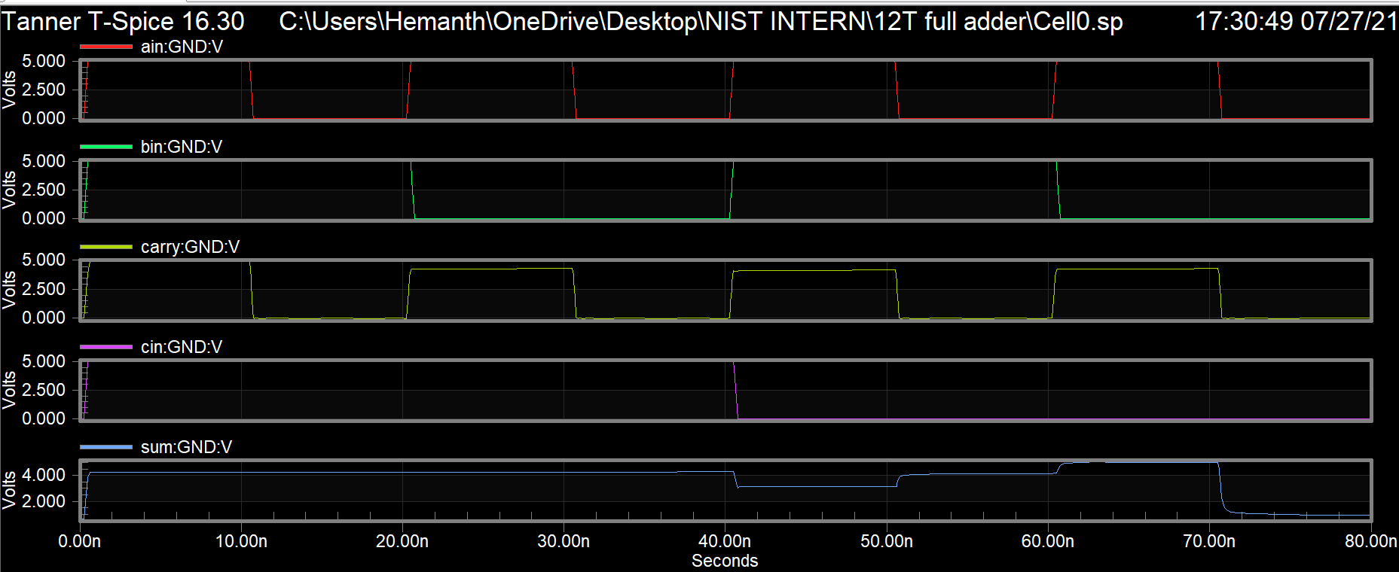
12T FULL ADDER WAVE FORM
Konda Hemanth Kumar

Slide 19
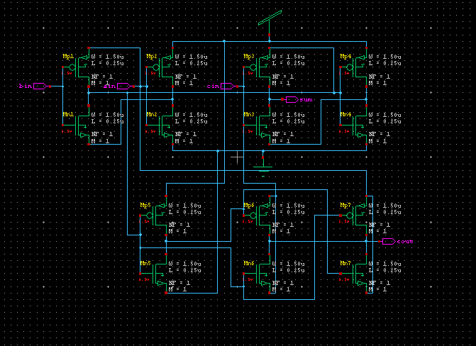
14T FULL ADDER CIRCUIT
Konda Hemanth Kumar

Slide 20
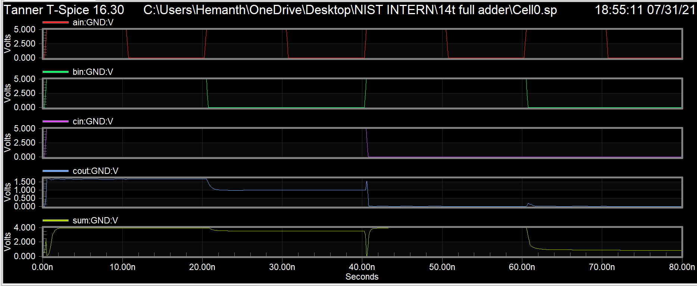
14T FULL ADDER WAVE FORM;
Konda Hemanth Kumar

Slide 21
Simulation Result :
Circuits | Power (W) | Delay (s) | PDP (fJ)
8T | 2.46e-006 | 192.3035p | 0.4731
12T | 7.74e-004 | 116.1369p | 89.9912
14T | 4.178e-004 | 100.8988p | 42.1558
10T | 3.789e-004 | 111.9723p | 42.4348
Konda Hemanth Kumar

Slide 22
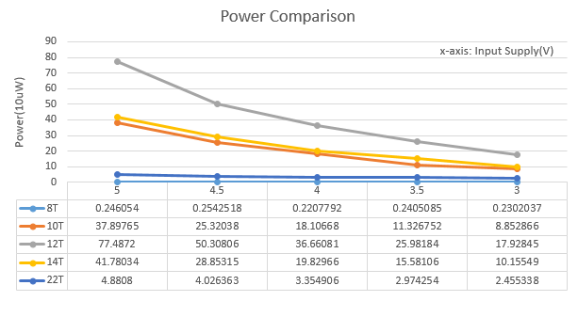
Comparision of power of all the circuits:
Konda Hemanth Kumar

Slide 23
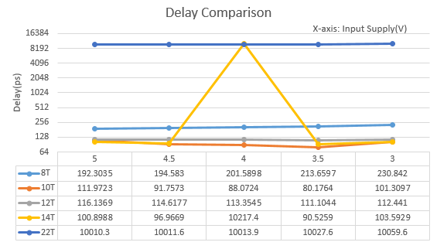
Delay Comparision
Konda Hemanth Kumar

Slide 24
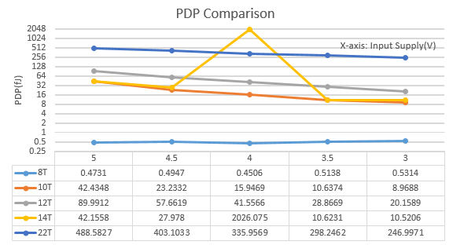
PDP COMPARISION
Konda Hemanth Kumar

Slide 25
Outcomes:
Technical Feasibility
Very less number of gates
Minimal Delay
Low Power Consumption
Low PDP
Better result than the previous existing circuits
Commercial Feasibility
Small in area
Easy to Design
Konda Hemanth Kumar

Slide 26
Applications:
Basic building block of on-chip libraries.
Configured according to designed complexity of arithmetic and numeric computations.
In processors and other kind of computing devices, adders are used in the arithmetic logic units.
Adders also used in the other parts of the processors, where they are used to calculate addresses, table indices, and similar operations.
Adders are used in graphical related applications, where there is very much need of complex computations, the GPU uses optimized ALU which is made up of full adders, other circuits as well.
Basically, Full-Adder is used in designing ALU and this ALU is used for wide variety of applications from designing CPU to GPU.
Konda Hemanth Kumar

Slide 27
Conclusion:
Due to the use of modern XOR-XNOR, multiplexer circuits the proposed full-adders have high speed and lower power consumption. From simulation results, the proposed full adders are found better as they have low power consumption, less delay and better power delay product compared to existing circuits. The proposed full-adders works good at various VDD values from 3v – 5v. And even the full adders work reliably at most of the conditions given.
Konda Hemanth Kumar

Slide 28
References:
Pyagasti Juveria, K. Ragini, “Low Power and high speed full adder using new XOR and XNOR gates”, IJITEE, ISSN: 2278-3075, Volume-8 Issue-8, June-2019.
Pramod Aladale, “Design of Low Power and High Speed Full Adder Cell Using New 3TXNOR Gate”, International Journal of Computer Science and Mobile Computing, ISSN 2320-088X, IJCSMC, Vol. 7, Issue. 6, June 2018, pg.31 – 36.
Tripti Sharma, K. G. Sharma, B. P. Singh and Neha Arora, “New Efficient Design for XOR Function on the Transistor Level”, Department of Electronics and Communication Engineering, 03 December 2010.
Konda Hemanth Kumar

Slide 29
Thank You
Konda Hemanth Kumar

